Slide 1
PS 217 Middle School Admissions Info Session

Slide 2
General Middle School Information
Middle school applications Open on October 9th, and the Deadline to apply is December 13th.
Families can now list any NYC public middle school on their application!
Different school programs have different eligibility requirements.
-There are zoned programs where students who only live in the zone can apply.
District programs where students who only live in the district can apply.
The same goes for boroughwide programs and citywide programs.

Slide 3
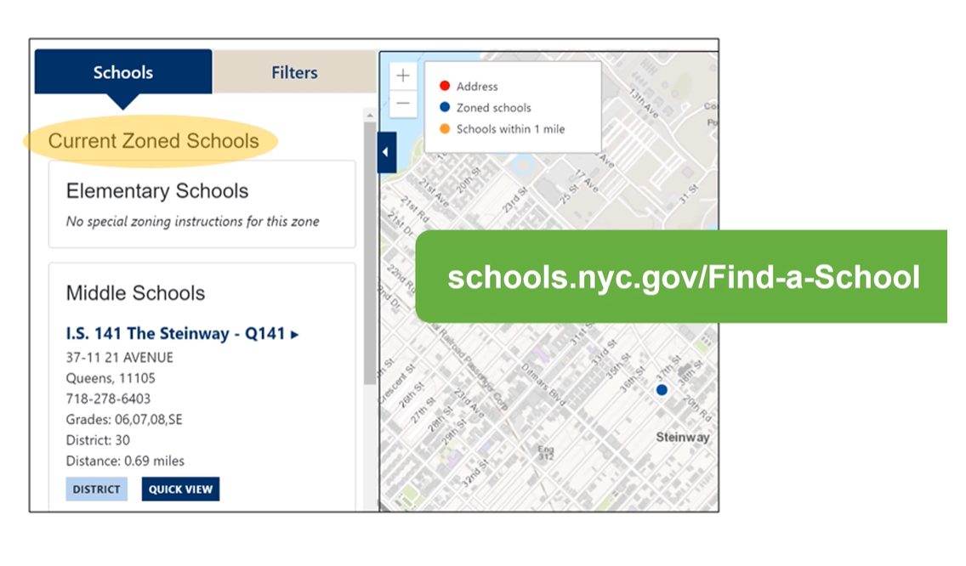
Finding your zoned school and District
Go to www.schools.nyc.gov/Find-a-school
Then type in your home address, borough, and the grade level your child is applying to which would be 6th grade.
After providing such information you will see your district listed in the schools displayed and your zoned schools will appear.

Slide 4
How to Apply to Middle School Part 1
First open Google Chrome or Safari
Then type in https://www.myschools.nyc/en/.
This site will be used to create and submit your child’s middle school application.
Once on the website you will click “Get Started” and then click “Create New Account” and fill out the required information “Parent/Guardian First & Last name, email address, and password.”
Then check your email for a message from MySchools. In that email, click the link to access your MySchools account.

Slide 5
How to Apply to Middle School Part 2
After clicking the link in your email, it will redirect you back to the MySchools website.
You will be asked to type in your “Contact Info, Mailing Address, and Language.” Then click submit.
Now connect your child to your account by clicking “Add a child.”
- You will need two things your child’s 9-digit Student ID # (can be found on a report card or contact the school to receive it)and ,
-Their Account Creation code which can be found in the welcome letter.

Slide 6
How to Apply to Middle School Part 3
After putting in their Student ID and Account Creation Code scroll down and click “Next”. The following screen will confirm that the child has been added to your account.
Now click “Go to dashboard” and your child should now be listed here.
Once you are fully logged in and your child has been successfully added, you can now explore every program that your child is eligible to attend
Keep in mind that only the programs your child is eligible to attend will be available as options.

Slide 7
MySchools Tutorial Video

Slide 8
How to build your application
https://vimeo.com/500080605?embedded=true&source=vimeo_logo&owner=1779280

Slide 9
Any Questions???
If you have any questions, please contact one of the following:
Mr. Ahmad, Parent Coordinator Ms. DePalma, Computer Teacher
arahmaan@schools.nyc.gov ddepalma@schools.nyc.gov
Ms. Ute, Pupil Accounting
jvansitteren@schools.nyc.gov

