Slide 1
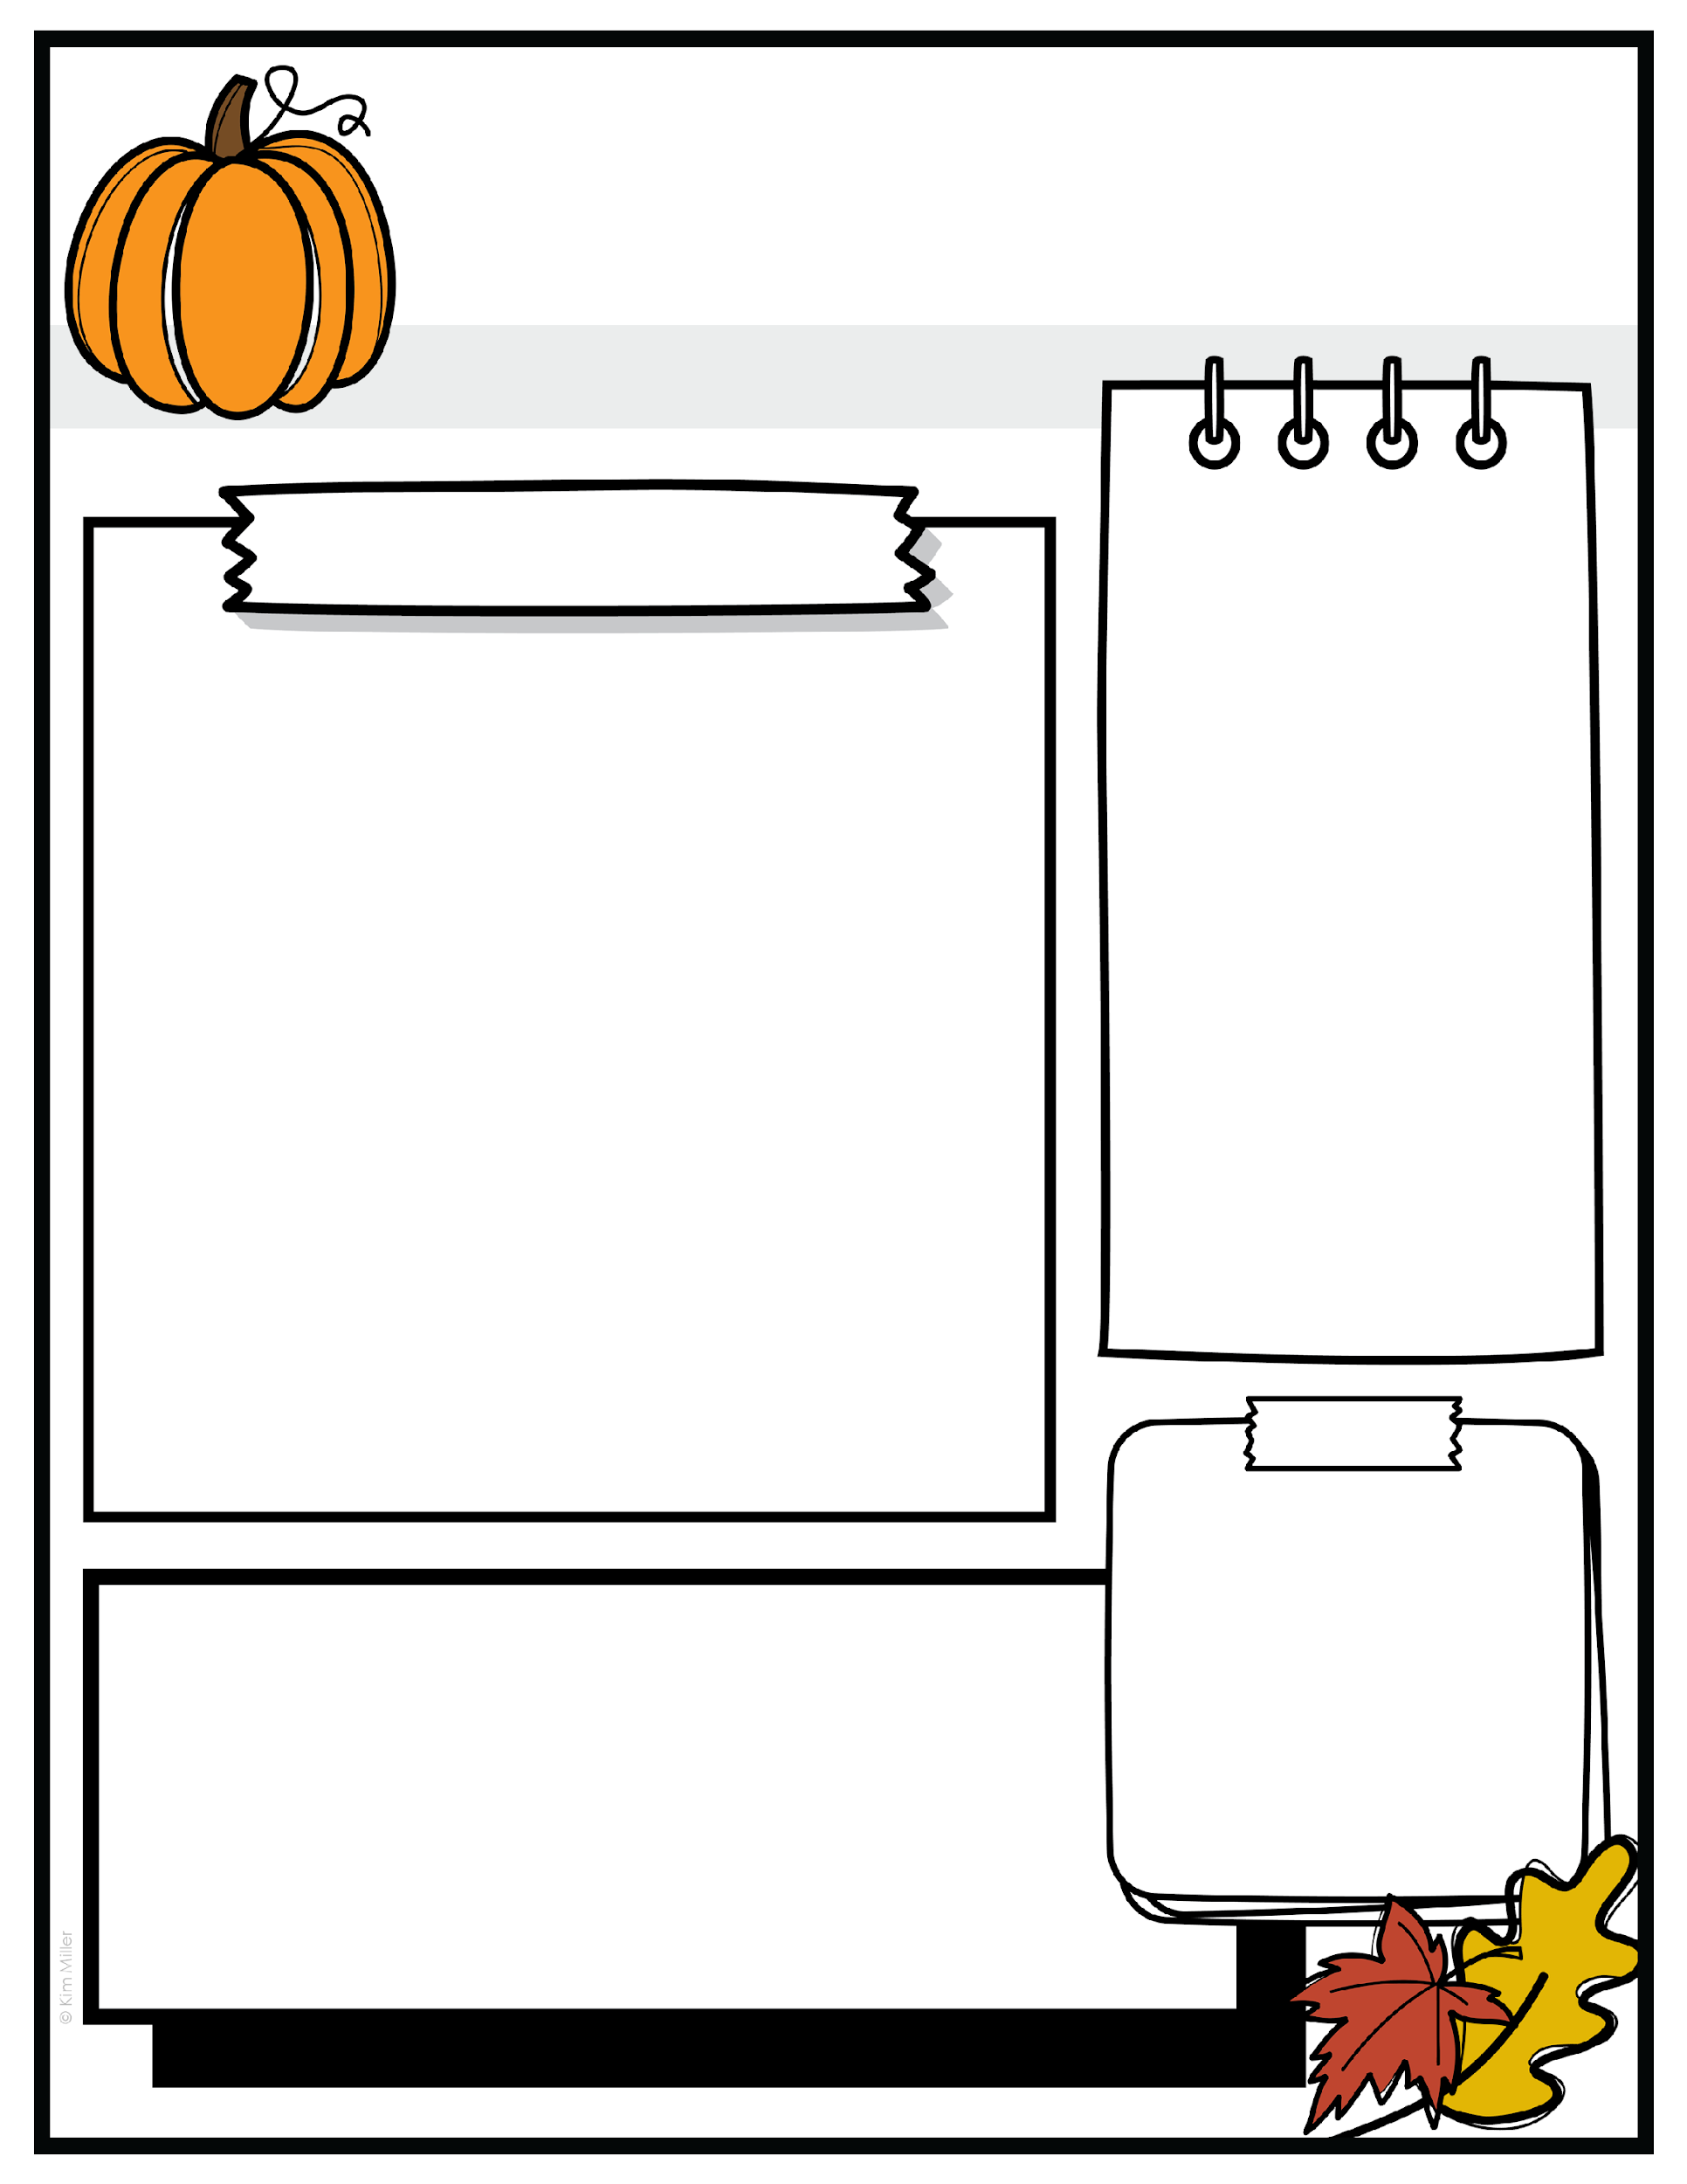



Pre-K
What we are learning
EVENTS
October 14th
PreK Picture Day
October 23rd
Hispanic Heritage Festival
October 30th
Join your child in the cafeteria at arrival time for a fun Fall craft
October 31st
Character Day parade
We are delighted to share that our Pre-K program implements The Creative Curriculum for Preschool.
The curriculum is designed to build each child’s confidence, creativity, and critical thinking skills through hands-on, project-based learning and focused, daily opportunities to build essential foundational skills in literacy and math.
In October, we will be studying the following topics:
Who works at our school?
How can we make and keep friends?
What sounds do we hear at school? Where do they come from?
What do we know about balls? What do we want to find out?
Do all balls bounce?
TO-DO
Send your black folder to school each day.
Be sure to send a crib sheet and small blanket the first day of each school week.
REMINDERS
Schools Closed
Oct. 2 – Yom Kippur
Oct. 13 –Indigenous Peoples’ Day/ Italian Heritage
Oct. 20 - Diwali

